Slide 1





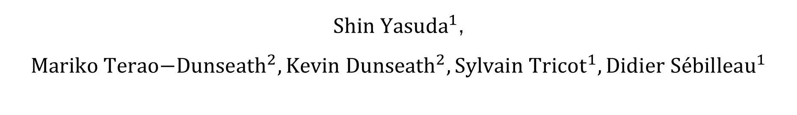
Modeling X-ray photoelectron diffraction forcing/accelerating convergence
${Shin Yasuda}^{1}$, ${{Mariko \text{Terao}\text{−}\text{Dunseath}}^{2},{\text{Kevin} \text{Dunseath}}^{2}, Sylvain Tricot}^{1},{\text{Didier} \text{S}\text{é}\text{billeau}}^{1}$
${}_{}^{1}{Department of Material and nanoscience, Institue of Physics, University of Rennes}$,France
${}_{}^{2}{Department of \text{molecular} \text{physics}, Institue of Physics, University of Rennes}$,France
Notes:
I have to change the logo to new

Slide 2
Institute of Physics of Rennes (IPR)
research unit affiliated with the University of Rennes and the CNRS
fundamental and applied physics with various interdisciplinary fields and operates on the Beaulieu campus with six research departments
partnering with industry, employing about 120 permanent staff and around 40 non-permanent staff, including doctoral students and post-doctoral fellows
6 components
Mechanics and
Glass
Molecular Physics
Soft Matter
Materials and
Light
Materials - Nanosciences
Divided Environments
Notes:
# Ph.D #permanent
1, 2, figure, 3の順番

Slide 3
^{Application importance: SrTiO3}
Small changes in structure responsible for essential properties in perovskites
Perovskites are of great technological importance (Resistance switching, Blue-light emission, Photo-catalysis, 2DEG…)
To understand and/or control these properties, we need:
Accurate crystallographic information,
Chemical resolution,
Surface sensitivity
E.g.: 2 dimensional electron gas formation
Oxygen vacancies (V_{O})
SrTiO₃
Fe
Sr
FeO + Fe
Ti
V_{O}
O
SrTiO_{3-x}
[001]
[001]
[010]
3,905 Å
[010]
[100]
[100]
Notes:
So as in the topic.
We are interested in the perovskites esp, Strontium Titanium Oxygen, or STO, because small changes in its structure are responsible for essential properties.
And it is of great technological importance.
The unit cell is a face-centred one, where we have 8 Srs at each vortex, 6 Oxygen at each centre of the faces and 1 Titanium in the centre.
Here is an example of 2-dimensional electron gas formation.
Firstly, on the left we have the iron and the STO layer and interface.
Secondly, oxygen migrates to the iron layer and we have oxidised irons and oxygen vacancies.
And if you look at the unit cell on the right, we have an oxygen vacancy and it causes the titanium to deviate upwards.
However, to understand and control such a property we need accurate crystallographic information, chemical resolution and surface sensitivity and the best way to do that is with X-ray photoelectron diffraction, called XPD.

Slide 4
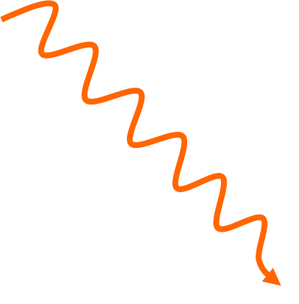
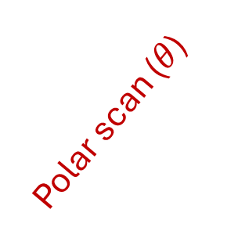
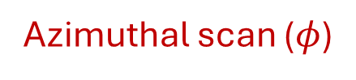
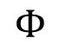
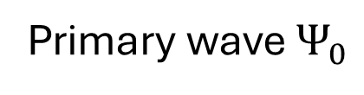
Principle of Photo Electron Diffraction
Azimuthal scan ($φ$)
Polar scan ($θ$)
Detector
X-ray
Surface
Kinetic energy
photoelectron
0
E_{vacuum}
Primary wave $Ψ_{0}$
0
$$Φ$$
Work function
E_{Fermi}
BV
3s
2p
2s
1s
Binding energy
Notes:
We need to understand the principle of XPD.
When the sample is rotated along the normal to the surface, we talk about an azimuthal spectrum and otherwise of a polar spectrum.
In the following, we will only deal with polar spectra.
Didier: The photoelectron gathers crystallographic information by repeated scatterings with atoms along its way out.

Slide 5
^{Need of comparison}
Why do we need to compare experiment to simulation ?
All the information we seek is inside the spectrum but we have no direct way to retrieve it.
This information can only be extracted accurately through comparison to a theoretical model
Framework: Multiple scattering theory
Real space approach, not k-space one
Notes:
Going further, it is valuable to compare experimental and simulation results.
The first reason is that all the information we seek is in the spectrum, but we have no direct way to retrieve it.
And this information can only be accurately extracted by comparison with a theoretical model, which is in the framework of multiscattering theory.

Slide 6
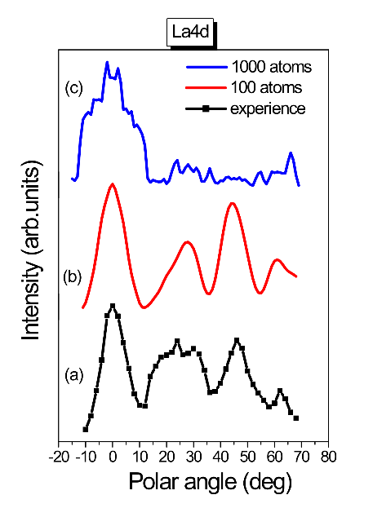
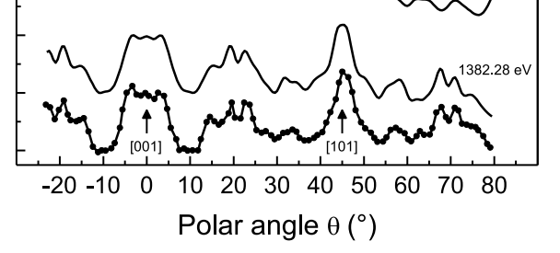

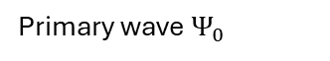
E.g: Experimental data Si vs LAO (LaAlO3⁾
Si(2p) in Si(001) substrate
La(4d) in LaAlO₃
Peaks of intensity along dense atomic directions
Polar scan of Si(2p) in Si(001) substrate
X-ray
Surface
[001]
[101]
Simulation needed for complete interpretation and quantitative information
Primary wave $Ψ_{0}$
S. Tricot, T. Jaouen, D. Sébilleau, P. Schieffer, J. Electron. Spectrosc., 256, 147176 (2022)
Fig. 2: PED calculation for LaAlO₃ (Mohamed Zanouni, Faculty of Sciences, Tangiers, Morocco)
Excellent agreement
No agreement at all
Where divergence comes from and how to cure it ?
Notes:
This is an example of the comparison.
On the left we have polar scans of the silicon 001 substrate.
The thick line is from an experiment so we have the main peaks corresponding to dense atomic directions.
And the smooth one is simulation.
Obviously we have excellent agreement between them.
On the other hand, we have a problem with the Lanthanum Alminum Oxygen. This is one of the perovskites.
Here the black line is an experiment and the red one is a simulation with 100 atoms.
In red we have almost a good fit to the experiment, but we are missing fine peaks in black.
So when we go to 1000 atoms in blue, some unwanted peaks appear.
We call these peaks divergences.
So now the question is "where does divergence come from and how can we cure it?

Slide 7
^{Computer code used: MsSpec}
MsSpec ([1])
Python-Fortran combined package to compute the differential cross-section for PED
MsSpec has:
Matrix inversion: Exact solution but with memory storage requirement then almost impossible for large clusters (> 1000 atoms)
Series expansion: perturbative solution, usually applicable for large clusters
Renormalization methods:
Some renormalization methods have been proposed. ([2])
Renormalization complex parameter, ω should be optimized to use them.
When not applicable
[1] Website of MsSpec: https://msspec.cnrs.fr/index.html
[2] Takatsu, A. et al., Simple renormalization schemes for multiple scattering series expansions, Phys. Chem. Chem. 24 5658–5668 (2022)
Notes:
To answer the questions, we are working on a specific package called MsSpec.
The matrix inversion is an exact solution in theory and should be the same as what we get from experiments.
SE: Perturbative means that it might have divergence.
On the arrow animation: When it is not applicable, we use renormalisation methods.

Slide 8
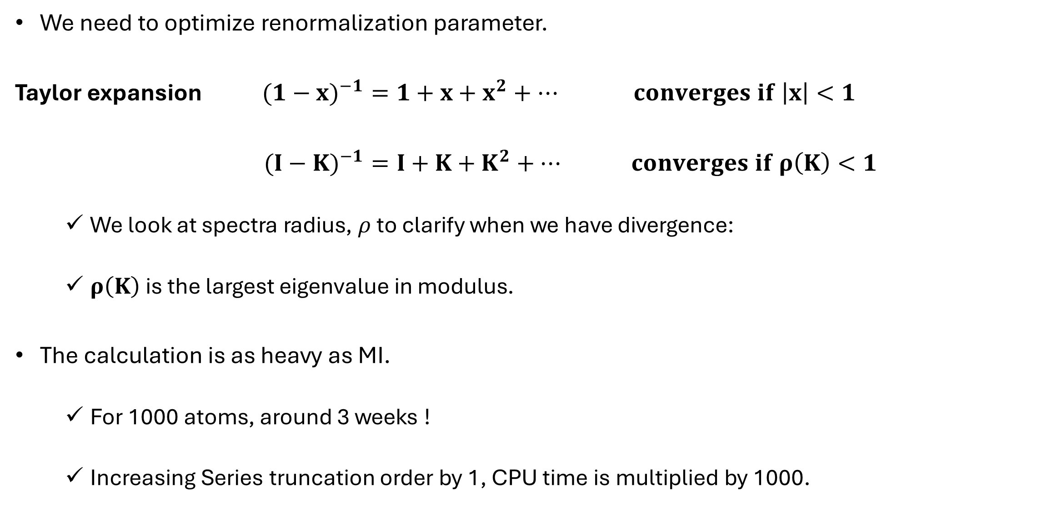
^{Calculation of omega parameter}
We need to optimize renormalization parameter.
Taylor expansion $({1−x)}^{−1}=1+x+x^{2}+… converges if \left|x\right|<1$
$({I−K)}^{−1}=I+{K+K}^{2}+… converges if ρ\left(K\right)<1$
We look at spectra radius, $ρ$ to clarify when we have divergence:
$ρ\left(K\right)$is the largest eigenvalue in modulus.
The calculation is as heavy as MI.
For 1000 atoms, around 3 weeks !
Increasing Series truncation order by 1, CPU time is multiplied by 1000.
We have discovered that the divergence is coming from atomic chains.
Notes:
Ok, we need to optimise the omega parameter to avoid the divergence.
Here is the proucess.
If we have something like (1-x)-1, it is easy to expand it in series like .....
And we know that it converges when...,.
In the codes, we have similar one in a matrix form except the convergence where the largest eigenvalue in the modulus <1.
We call it spectral radius which is ρ.
But All eigenvalues are calculated to get spectral radius so the calculation is as heavy as the MI.
For example, it takes about 3 weeks for 1000 atoms.
And in this expansion, if we increase the order of the expansion by 1, the CPU time is multiplied by 1000 in the case where we have 1000 atoms.
We have discovered that the divergence comes from atomic chains, which are easier to analyse than large clusters.

Slide 9
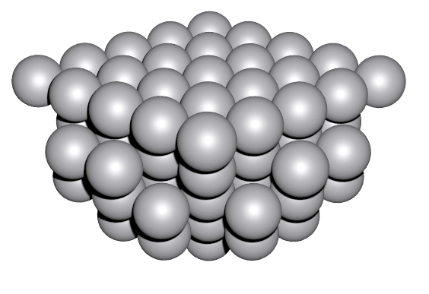

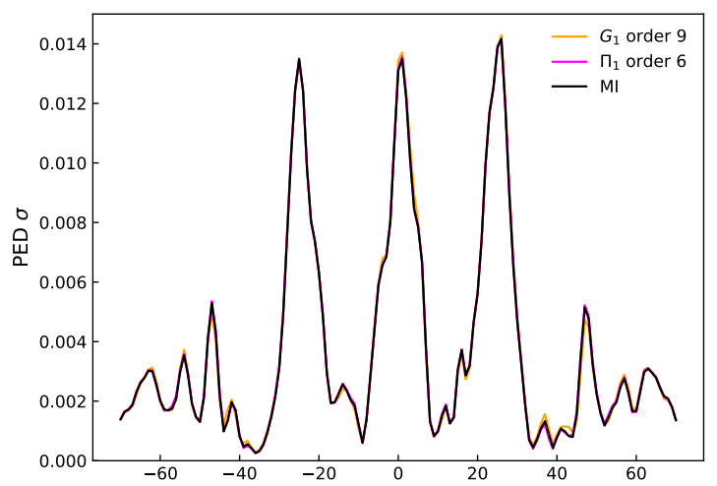
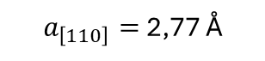
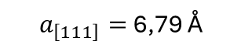
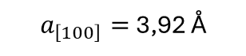
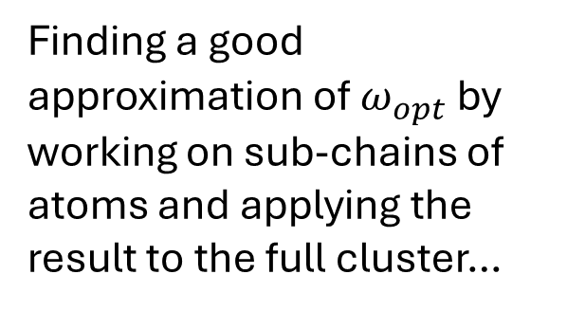
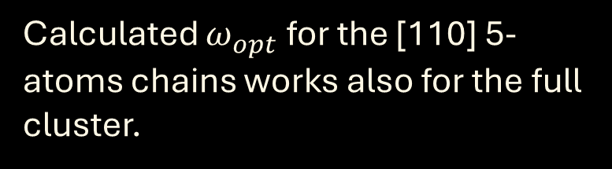
^{Methodology for atomic chains}
Methodology: calculate ω only for dense atomic chains and then use it for the full cluster.
E,g.:
Pt
84 atoms cluster of Pt
Spectral radius = 1,09 @ 410 eV
Spectral radius follows the same trend than Perovskites
Can still be computed by MI to aid comparison
Emitter atom
Finding a good approximation of $ω_{opt}$ by working on sub-chains of atoms and applying the result to the full cluster…
Calculated $ω_{opt}$ for the [110] 5-atoms chains works also for the full cluster.
G₁ order n = 9
Π₁ order n = 6
MI
$a_{\left[111\right]}=$ 6,79 Å
Π₁ is faster than G₁
CPU ∝(N_{at}-1)^{n}
Pt
[001]
[010]
[100]
$a_{\left[110\right]}=$ 2,77 Å
$a_{\left[100\right]}=$ 3,92 Å
Polar angle (degree)
Notes:
Then we have the methodology to calculate ω only for dense atomic chains and then use it for the full cluster.
Here we tested the cluster of a 84 Pt cluster.
Photoelectron kinetic energy is 420eV not high.
But we have the spectral radius above 1 thus it shows divergence. And in this figure, the black is MI with three peaks corresponding to dense atomic chains here.
And the pink and orange are renormalizations which are G and pi by ω from [110] 5 atomic chains.
For G1 and P1, the truncation orders are important because the CPU time is propotional to…
And we see that Pi is faster than G1.
83^9, 6
It is quite early.
How about STO cluster ?
Even the monoatomic cluster had the divergence and STO is a heterostructure.

Slide 10
Atomic chains in STO[111] direction
8_TiSr-atomic chain at 1018.80eV
Ti
Emitter
3.382Å
Backscattering
Forward scattering
Scattering factor of Sr at 1018.80eV
Notes:
Let’s use it to the atomic chain of STO. Here we have a Titanium-Strontium chain with the atomic distance, 3.4 and this photoelectron kinetic energy.
And it is just a linear chain so what we consider are forward scattering and backscattering from an atom.

Slide 11
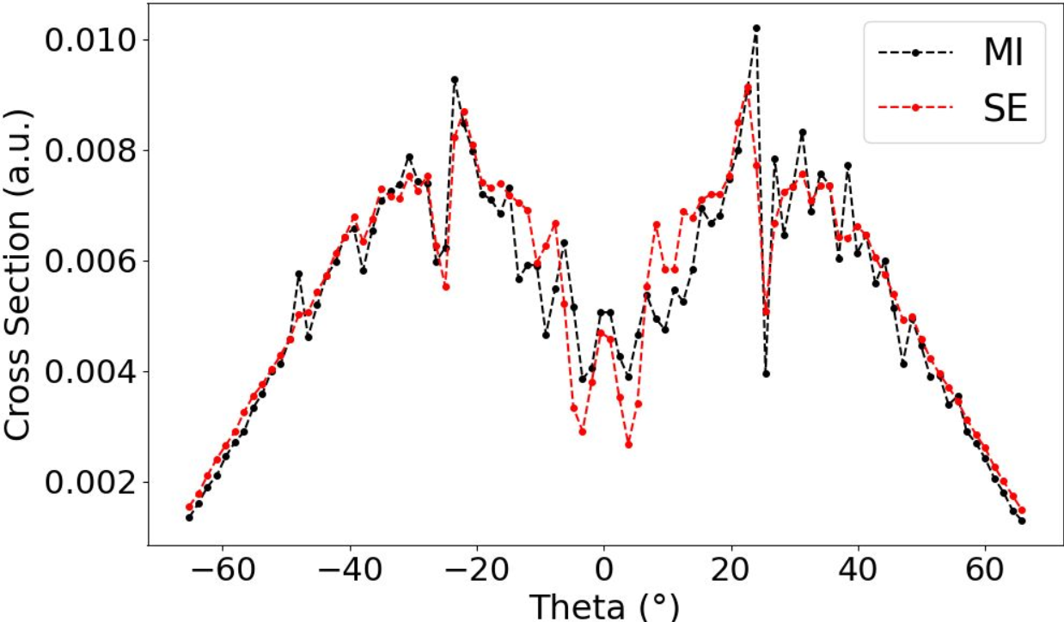
Result: PED scan with Ti(2p) at 1018.80eV
Divergence !
Removing all backscattering
Almost agrees with MI

Slide 12
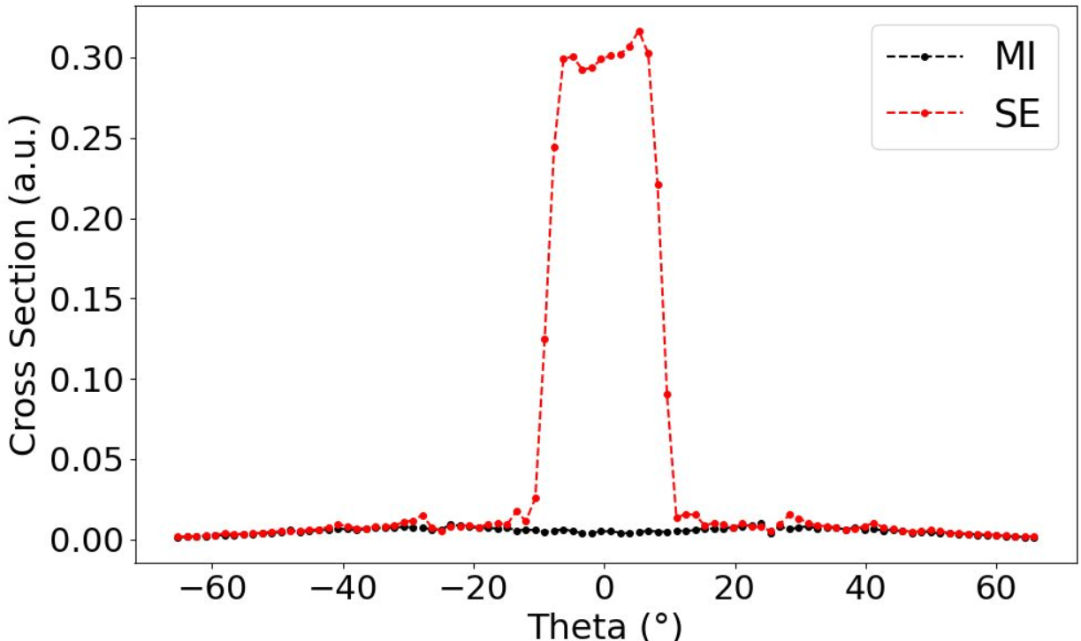
Result: PED scan without backscattering
Taylor truncation order n = 7
Central peak ten times more than MI
Notes:
We have globally the same spectrum as MI.

Slide 13
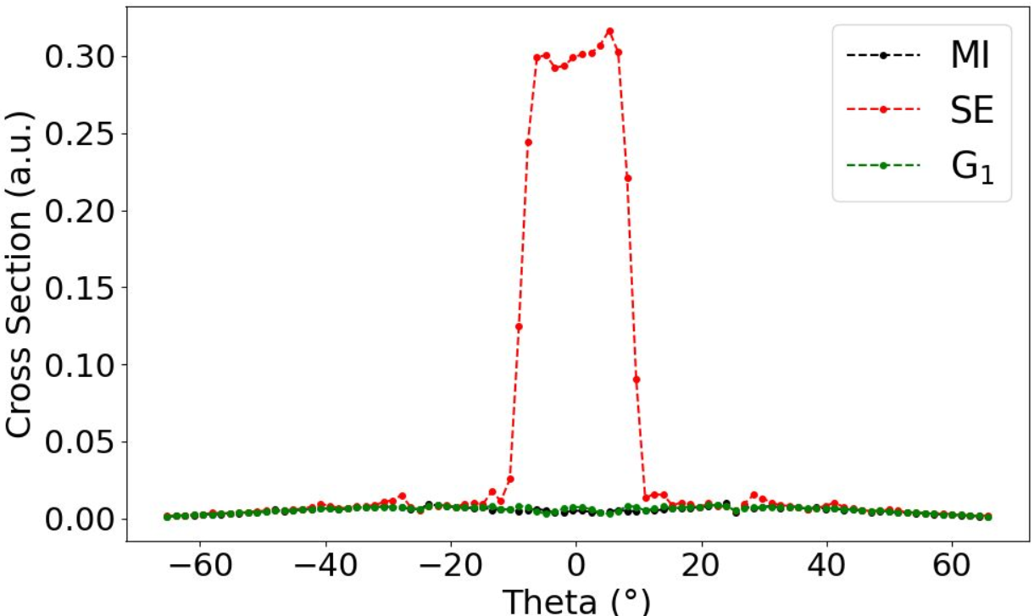
Result: PED scan with renormalization
Renormalization with G_1 (n=7)
Almost agrees with MI
Notes:
Additionally, we tested the renormalization method here.
We clearly see that the divergence vanishes and we have good agreement with MI by the renormalization.
Didier: We need to have the same n here as SE for the comparison.
But it is possible to have higher n and in this case we have more nice agreement with MI.

Slide 14
^{Summary}
Results and conclusions:
We have found out divergence on SrTi atomic chain.
We have demonstrated that it comes from backscattering.
Hereafter:
For STO clusters, MI is impossible and we have to compare our calculation to experiments.
We need to speed up renormalization.
Second part of my internship + article in preparation
Notes:
Frame of our aim: To apply also path filtering with renormalization for calculation

Slide 15
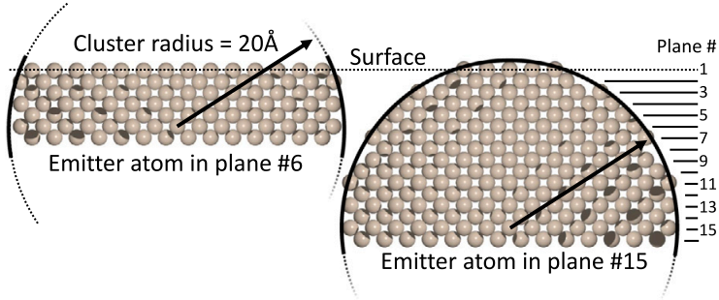
Recipe for creating clusters
This figure is cited from [1].
The cluster tested is shaped like a semisphere (right) based on a sphere.
I created a cylinder-shaped cluster with a large number of atoms, eliminated all atoms out of a sphere given a radius, and cut the part below a given z coordinate.

Slide 16
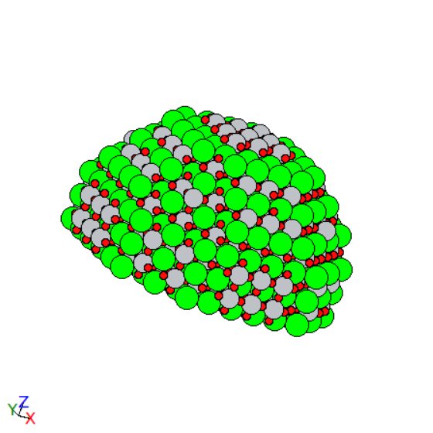
^{Simulating clusters: STO}
STO cluster with Ti emitter
1920 atoms
Number of planes: 12
Radius of the semisphere: 21Å
Cutting sphere in z any below z = -1.1*3.905/2
Ti emitter at the second plane from the bottom

Slide 17
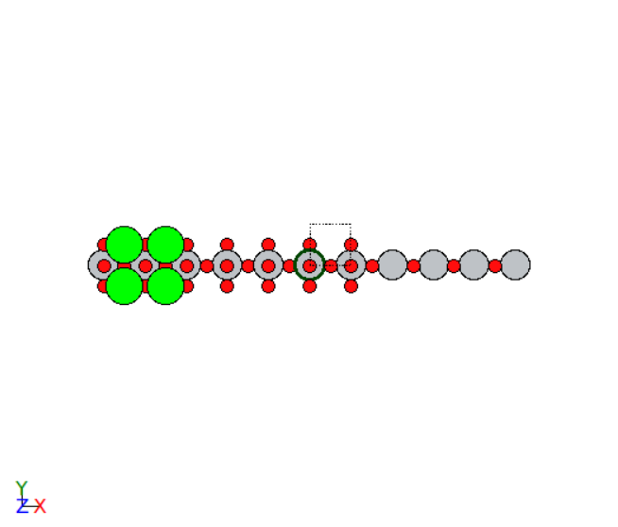
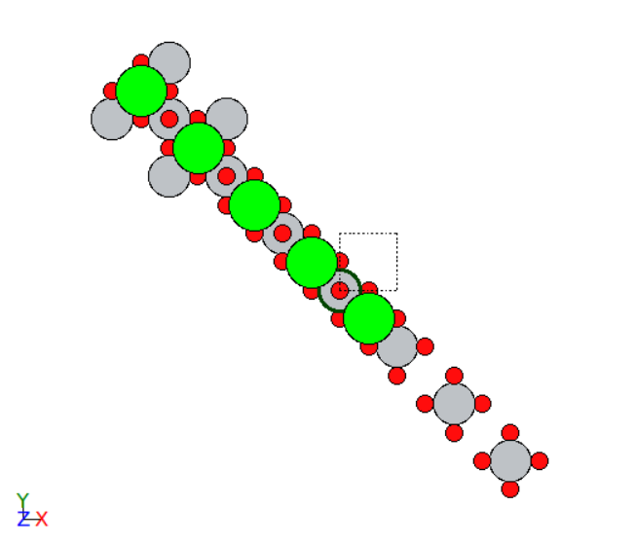
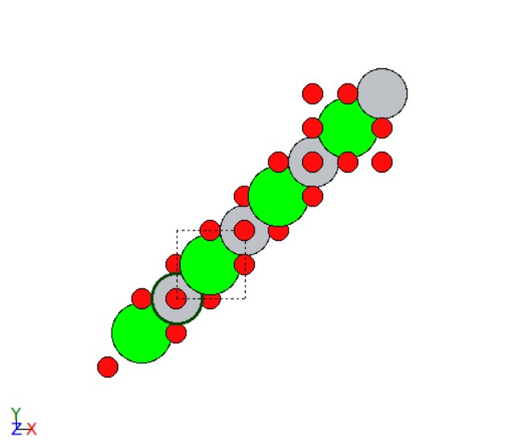
^{Simulating clusters: STO}
Atomic cones that diverge
[-100]
[-110]
Every cone is defined by a half-angle of 2.5°
As well divergence we can expect from [010], [110], [-111], [1-11], and [11-1] by rotation along z axis.
[111]

Slide 18
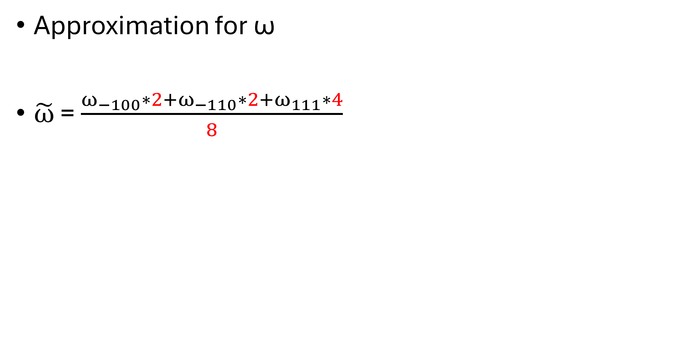
^{Simulating clusters: STO}
Approximation for ω
$\tilde{ω}$ = $\frac{ω_{−100}∗2+ω_{−110}∗2+ω_{111}∗4}{8}$
…Averaged ω
Total number of ωs
[-100] and [010]
[-110] and [110]
[111] , [1-11], [-111], and [11-1]

Slide 19
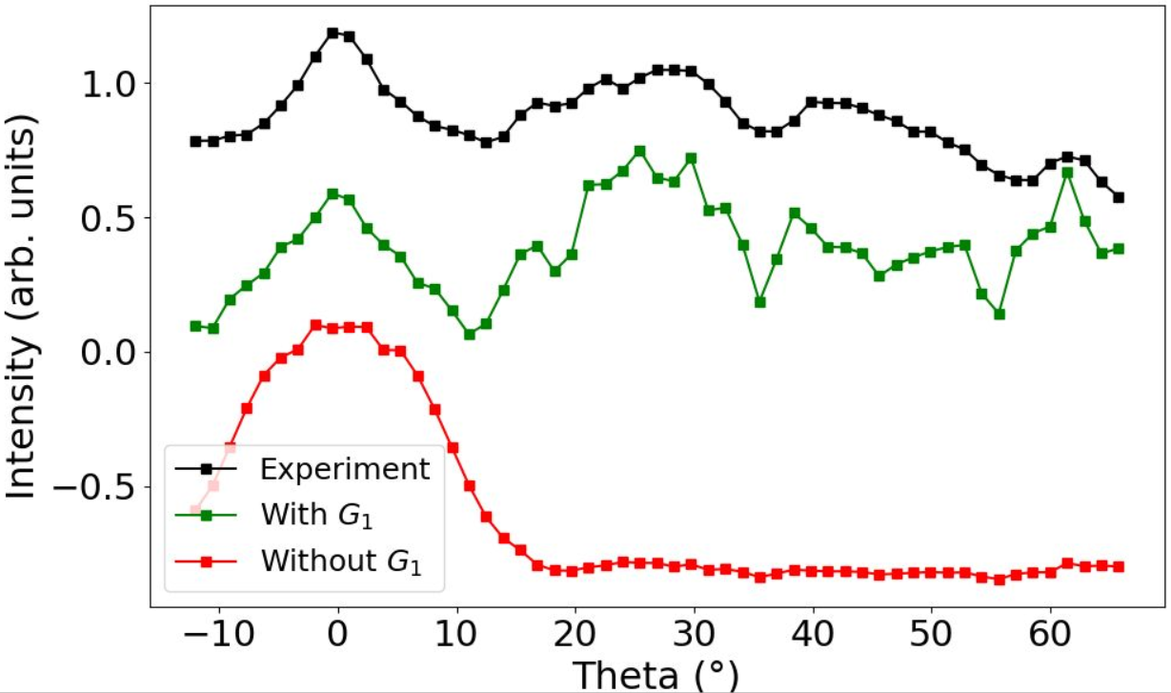
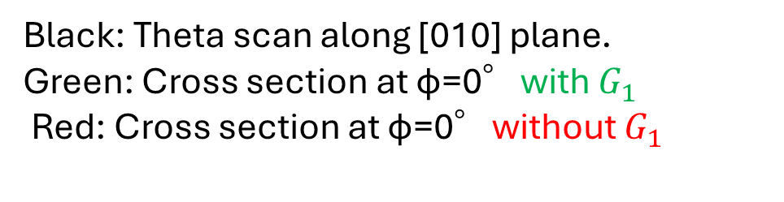
Simulation and Experiment
Sample area: 10 * 10 mm
Black: Theta scan along [010] plane.
Green: Cross section at φ=0°with $G_{1}$
Red: Cross section at φ=0°without $G_{1}$

Slide 20
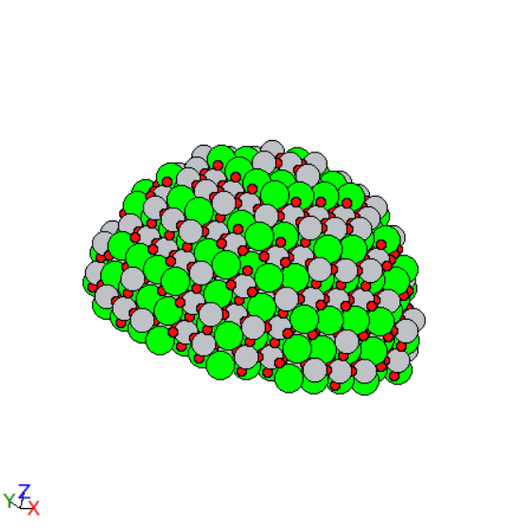
STO cluster with O emitter
1688 atoms
Number of planes: 10
Radius of the semisphere: 21Å
Cutting sphere in z any below z = -1.1*3.905/2
O emitter at the second plane from the bottom

Slide 21
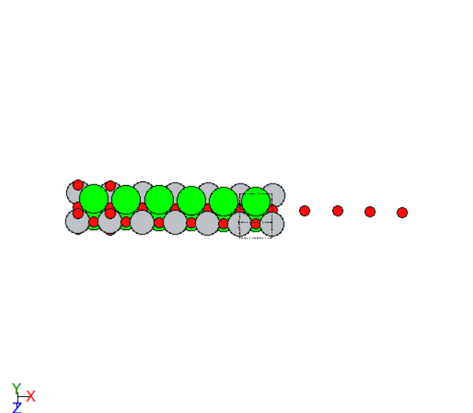
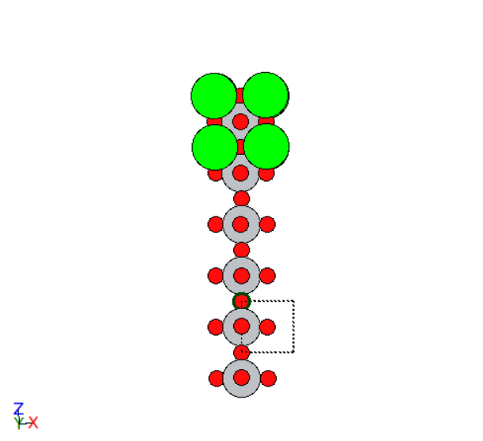
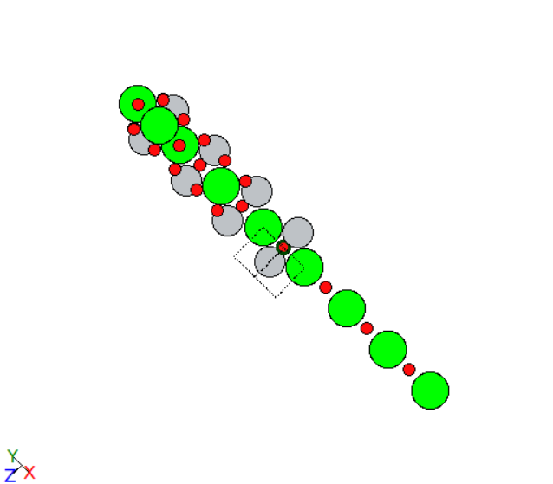
Atomic cones that diverge
[-100]
[001]
[-110]

Slide 22
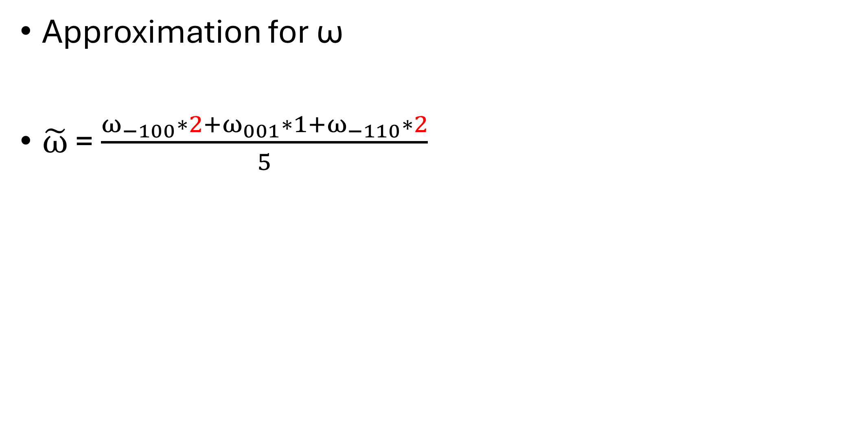
^{Simulating clusters: STO}
Approximation for ω
$\tilde{ω}$ = $\frac{ω_{−100}∗2+ω_{001}∗1+ω_{−110}∗2}{5}$
…Averaged ω
Total number of ωs
[-100] and [010]
Only [001]
[-110] and [110]

Slide 23
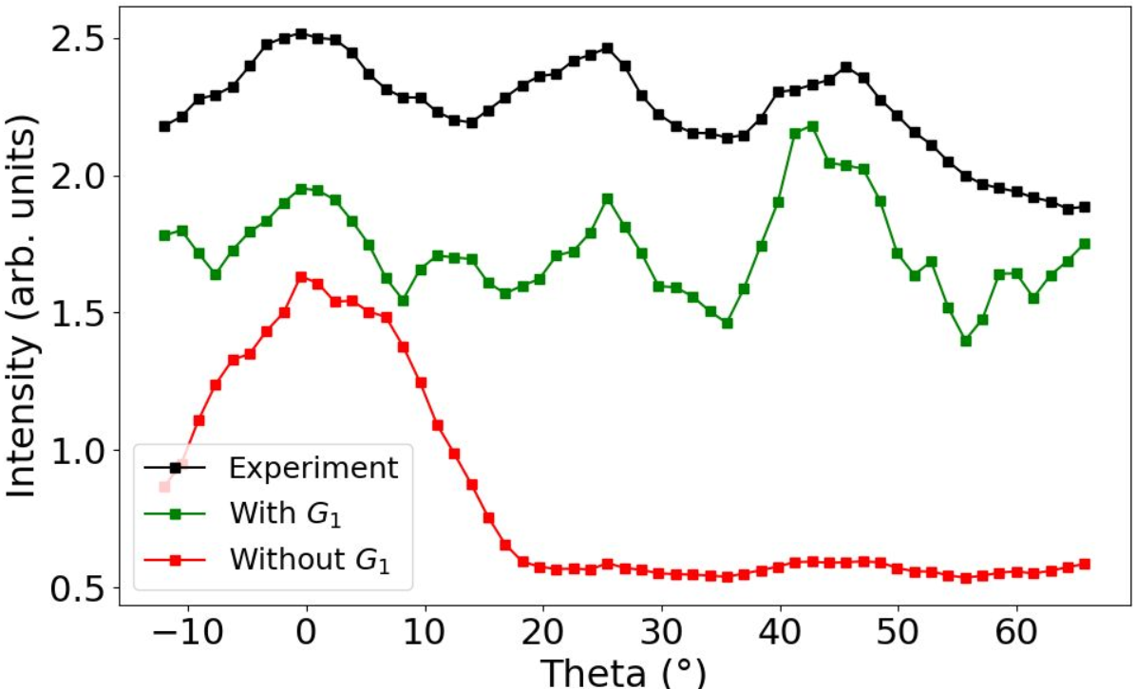
Simulation and Experiment
Sample area: 10 * 10 mm
Black: Theta scan along [010] plane.
Green: Cross section at φ=0°with $G_{1}$
Red: Cross section at φ=0°without $G_{1}$

Slide 24
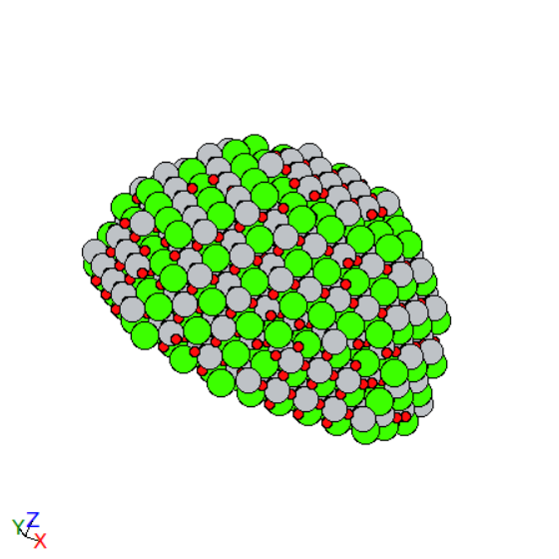
CTO cluster with Ti emitter
1960 atoms
Number of planes: 12
Radius of the semisphere: 21Å
Cutting sphere in z any below z = -1.1*3.905/2
Ti emitter at the second plane from the bottom

Slide 25
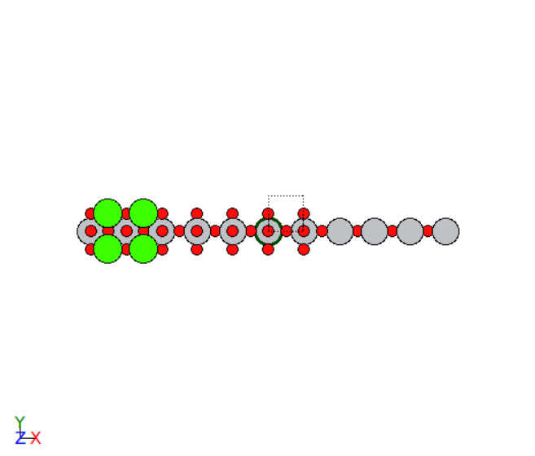
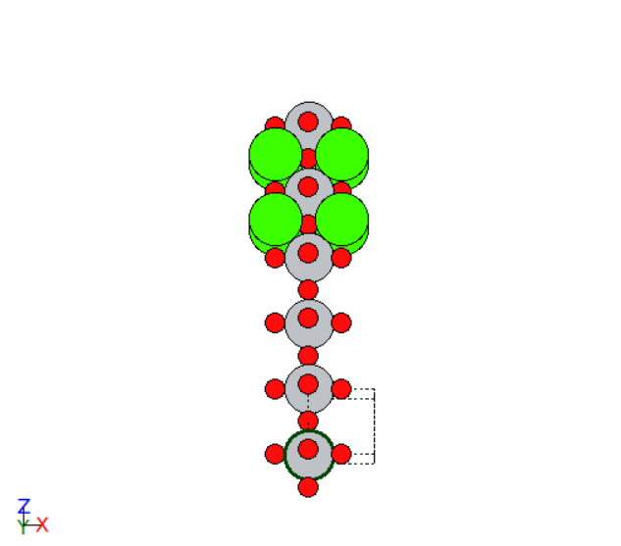
Atomic cones that diverge
[-100]
[001]

Slide 26
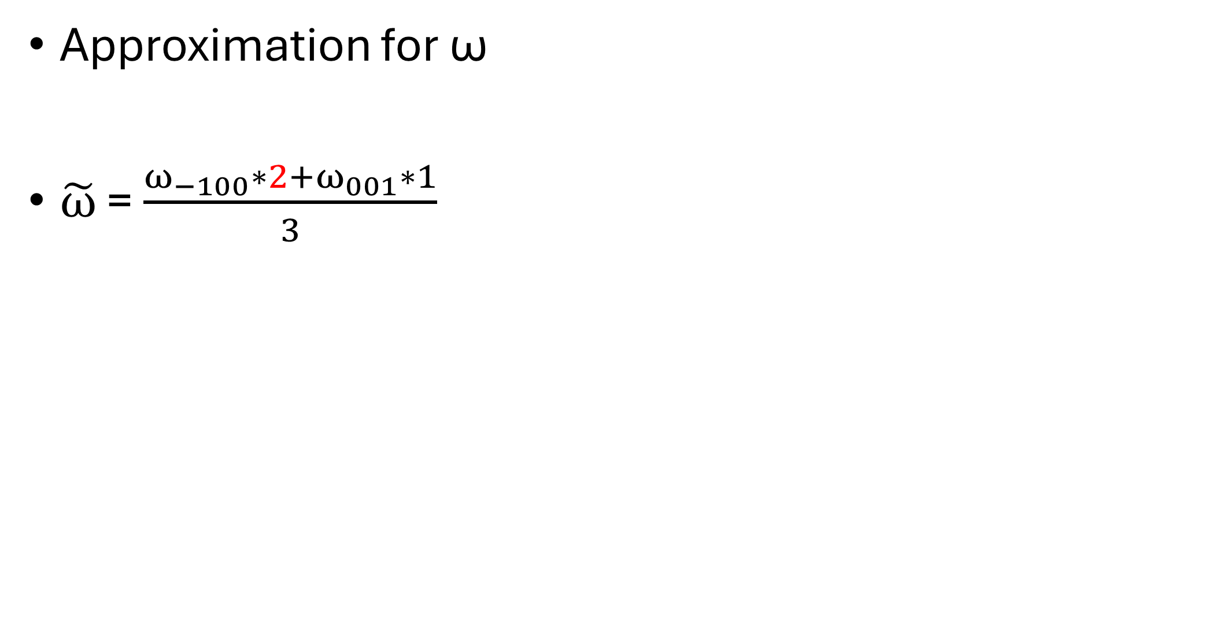
^{Simulating clusters: STO}
Approximation for ω
$\tilde{ω}$ = $\frac{ω_{−100}∗2+ω_{001}∗1}{3}$
…Averaged ω
Total number of ωs
[-100] and [010]
Only [001]
[-110] and [110]

Slide 27
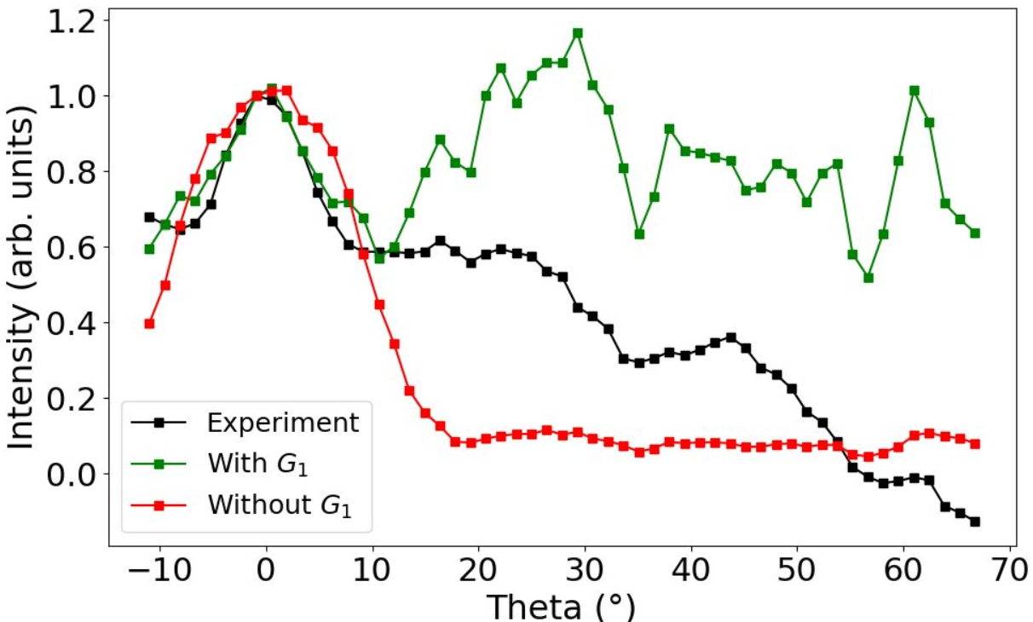
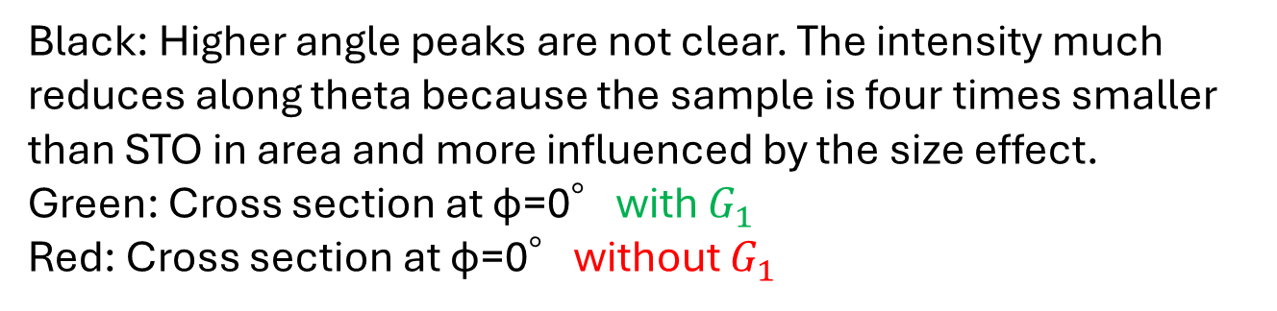
Simulation and Experiment
Sample area: 5 * 5 mm
Black: Higher angle peaks are not clear. The intensity much reduces along theta because the sample is four times smaller than STO in area and more influenced by the size effect.
Green: Cross section at φ=0°with $G_{1}$
Red: Cross section at φ=0°without $G_{1}$

Slide 28
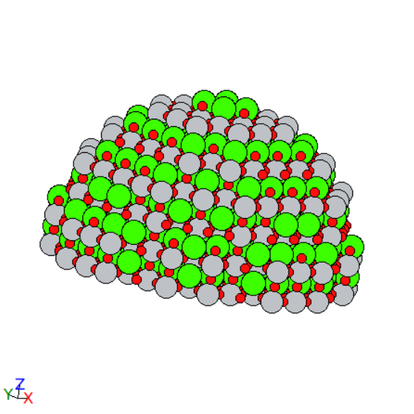
CTO cluster with O emitter
1752 atoms
Number of planes: 10
Radius of the semisphere: 20Å
Cutting sphere in z any below z = -1.1*3.905/2
O emitter at the second plane from the bottom

Slide 29
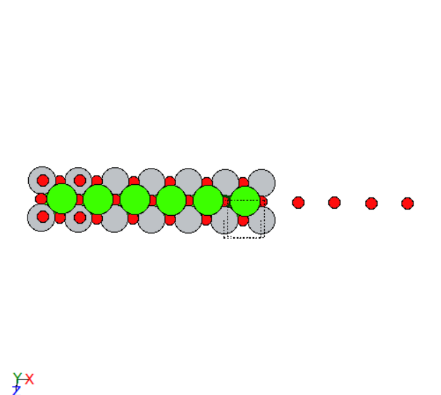
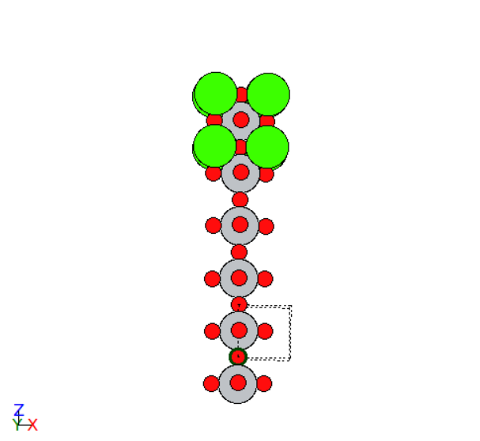
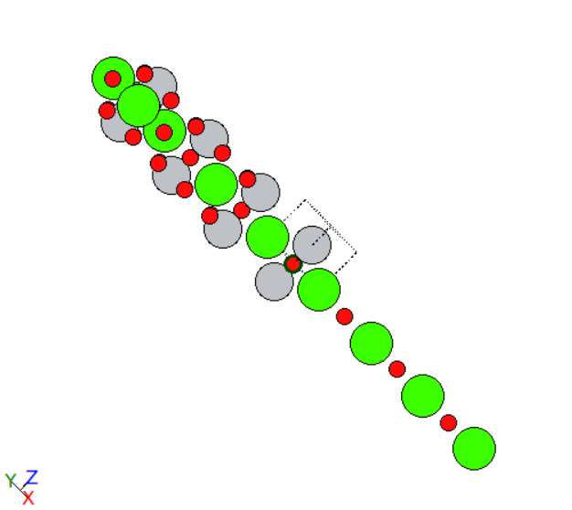
Atomic cones that diverge
[001]
[-100]
[-110]

Slide 30
^{Simulating clusters: STO}
Approximation for ω
$\tilde{ω}$ = $\frac{ω_{−100}∗2+ω_{001}∗1+ω_{−110}∗2}{5}$
…Averaged ω
Total number of ωs
[-100] and [010]
Only [001]
[-110] and [110]

Slide 31
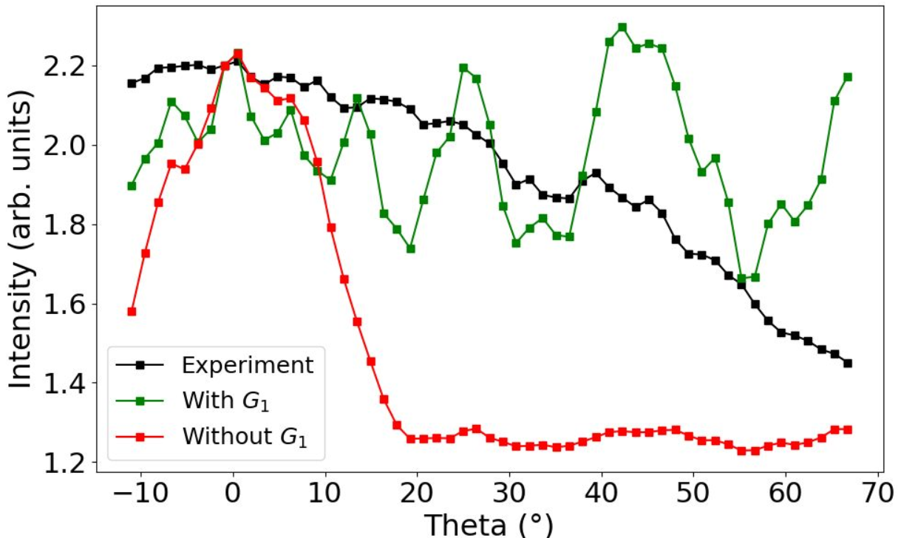
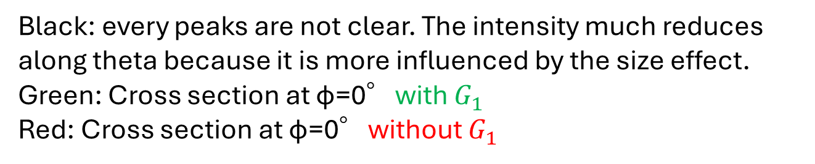
Simulation and Experiment
Sample area: 5 * 5 mm
Black: every peaks are not clear. The intensity much reduces along theta because it is more influenced by the size effect.
Green: Cross section at φ=0°with $G_{1}$
Red: Cross section at φ=0°without $G_{1}$

Slide 32
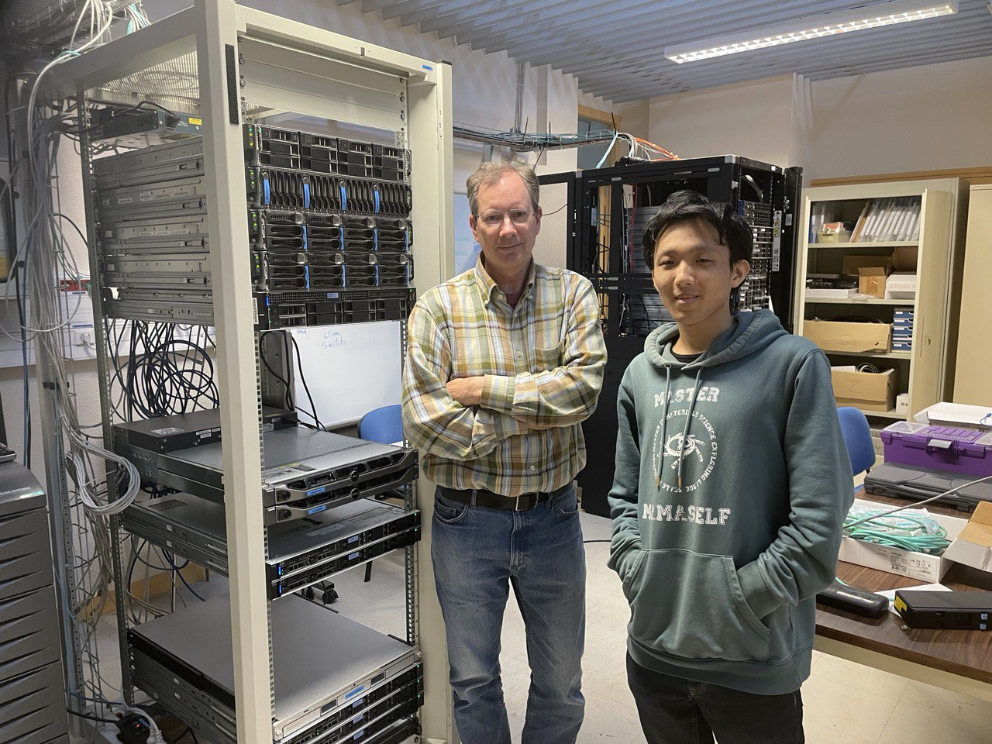
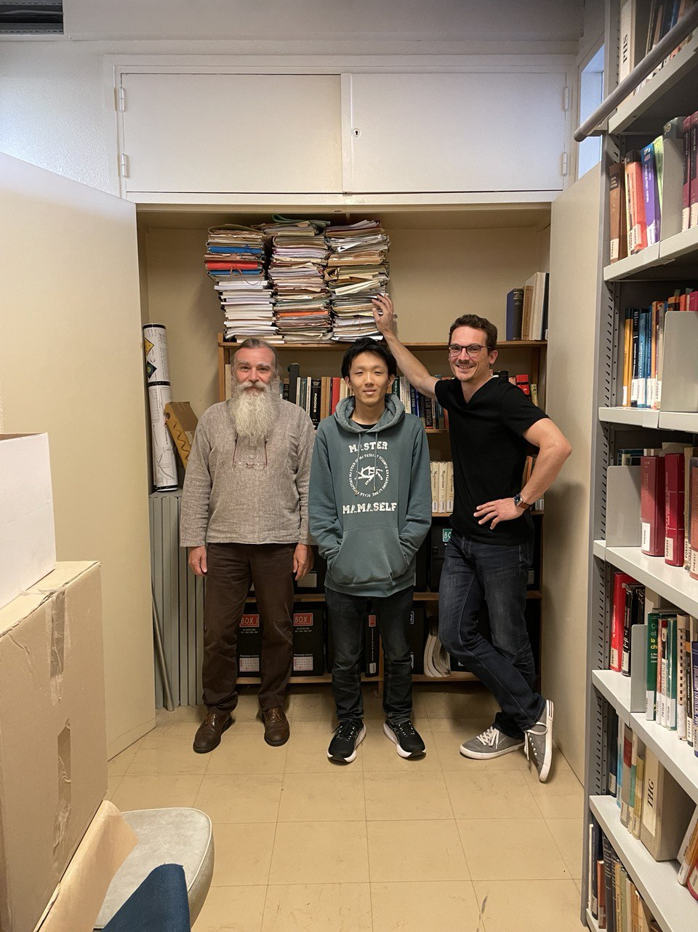
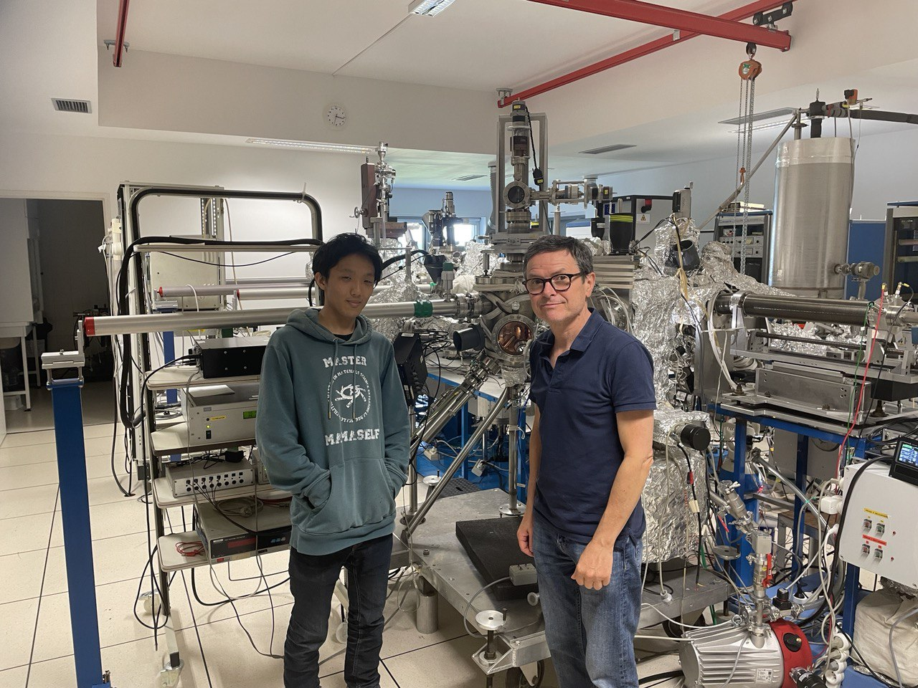
Thank you very much for all
and thank you for listening.

Slide 33
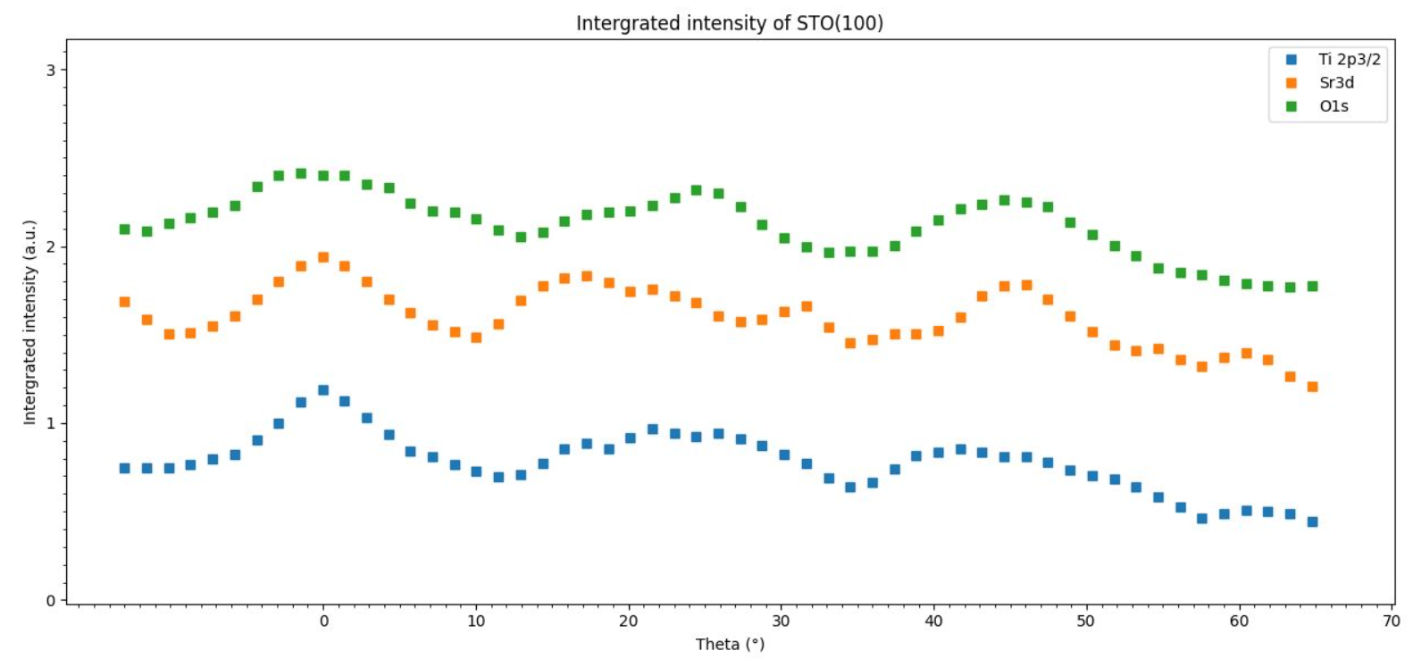
We would like to retrieve…

Slide 34


^{Renormalization: origin of} $ω$
SE
$({I−K)}^{−1}=I+{K+K}^{2}+…$ diverges
Idea
Mix $I$ and $K$ with parameter ω:
$$G_{1}= \left(1−ω\right)I+ωK⇒({I−K)}^{−1}=ω({I−G_{1})}^{−1}$$
We hope for some$ω$parameter
$$ρ\left(G_{1}\right)<ρ\left(K\right)$$

Slide 35

^{State of the art and PED}
New properties of materials: related to the perfect control of their crystallographic properties
Accurate crystallographic information, Chemical resolution, Surface sensitivity…
Differential cross section: Angular distribution of a detected electron at device
Fig.2: PED experimental setup, cited from [1].
[1] Website of MsSpec: https://msspec.cnrs.fr/index.html

Slide 36


^{State of the art and PED}
Image from $\text{Didier} \text{S}\text{é}\text{billeau}$

Slide 37
9_SrSr-atomic chain at 1344.50eV
Atomic chains seriously cause divergence ?
θ
Sr
z
0
3.905Å

Slide 38

Atomic chains seriously cause divergence ?
Taylor truncation order n = 7

Slide 39

Removing all backscattering
Almost agrees with MI

Slide 40
N ~ Nat*(lmax+1)**2
Ek = 40eV, lmax = 4
Ek = 1000eV, lmax = 15
Ek = 8000eV, lmax = 50

Slide 41
^{Issue for STO}
High truncation order of scattering paths
High kinetic energy for photo electron (~1000eV) (lab condition)
Electron Mean Free Path is large (19Å: larger clusters)
High consumption of scattering orders
Sr has higher backscattering factor than Ti and O
Forward scattering factor > lattice parameter
Notes:
The figure of SF for Sr
Remove it work on transition to the next slide with explanation

Slide 42


^{Calculation time}
Calculation time is propotional to the number of paths taken into account (not the atomic species and structure,…purely geometric way !):
E.g.1: 3 Sr atoms, scattering order = 2
X-ray
$$e^{−}$$
0
1
1
0
2
$$e^{−}$$
Some other scatterings taken into account…
Totally…7 !
It doesn’t take even 1 minutes to calculate !

Slide 43

Divergence indicator - Spectral radius -
In PED, we focus on differential cross section. (reflecting the structure of material)
It’s associated with the scattering path operator:
$$τ=T({I−G_{o}T)}^{−1}$$
Physic is easy !
-$T$: scattering by individual atom with potential
-$G_{0}$: free propagation of an electron from atom to atom
We need to solve the eigenvalue equation of$τ$:
We have to inverse the matrix,$({I−G_{o}T)}^{−1}$→ Matrix inversion method
It is mostly impossible because the matrix size is huge for clusters.

Slide 44

Instead of it:
$${\overline{τ}}^{ji}={\overline{T}}_{i}δ_{ij}+{\overline{T}}_{j}G_{o}{\overline{T}}_{i}+\sum_{k≠i,j}{{\overline{T}}_{j}G_{o}{\overline{T}}_{k}G_{o}{\overline{T}}_{i}}+…$$
This is looking like:
$$({1−x)}^{−1}=1+x+x^{2}+…$$
where x $≅G_{0}T$ (don’t check your math !)
It diverges at $x>1$.
- In this regard, we have divergence if spec$\left(G_{0}T\right)>1;$absolute value of some eigenvalue is above 1.
- We introduce spectral radius:
$$ρ=\max_{λ}{abs(λ)}$$
- Then we may say:
$ρ>1 \underset{⇔}{def}$ (Divergence appears)

Slide 45

Success of Renormalization methods
Mainly, three methods have been proposed and successful to break the divergence !
E,g.: G_1 (approximation at n=1, enough for most of cases…)

Slide 46

Success of Renormalization methods
All spectra are:
Spectral radius > 1

Slide 47

Success of Renormalization methods
Using G_1 is good:
Spectral radius < 1

Slide 48

Success of Renormalization methods
Others:
=
G_1
Around the same distribution and same spectral radius as G_1 !

Slide 49

Success of Renormalization methods
Others:
Most condensed around the center; expected to converge fastest !

Slide 50


^{Scattering factor}
Scattering amplitude, f(θ) represents an angular part of the spherically scattering wave:
Outcoming wave: Spherical
$$e^{ikz}$$
f(θ) $\frac{e^{ikz}}{r}$
z
Scatterer
Incoming X-ray: Plane wave

Slide 51



^{Scattering factor}
Scattering factor is the largest in forward and backward for Sr

Slide 52



^{Scattering factor}
High consumption of scattering orders:
E.g.: 4 Sr atoms, scattering order = 3
We can do a few scattering events in PC, but it’s not few for back scatterings !
$$e^{−}$$
1
2’
2
3
Sr
3.905Å
$$e^{−}$$
Certain error per each scattering
High error accumulation

Slide 53

^{Scattering vs calculation time}
~12h
Ti
3.382Å
Emitter
~3h

Slide 54


^{Experimental setup}
Energy Source
The energy of X-ray source should be higher than the orbital energy
$$E_{e} = hv − E_{o} − W$$
Geometry
Cluster orientation, angles of X-ray Source, etc…
Cluster detail
Orbital energy for an emitter (For STO, Sr Ti and O applies)
Source energy
Orbital energy
Work function ~ 4 – 5 eV, negligible
Kinetic energy of $e^{−}$

Slide 55
Experimental setup - Energy Source – [3]
We have two considerations:
Line width must not limit the energy resolution
Energy must be high enough
In general, two types of materials are used for energy source, Al and Mg.
Line width less than 1.0eV
High energy
Moreover, ease of fabrication and stability under electron bombardment
Energies and widths of some characteristic soft X-ray lines (excerpted from )
Line | Energy,eV | Width,eV
Mg Kα | 1253.6 | 0.7
Al Kα | 1486.6 | 0.85
[3] D.Briggs and M.P.Seath PRACTICAL SURFACE ANALYSIS SECOND EDITION VOLUME 1 – Auger and X-ray- Photoelectron Spectroscopy (1990) (p51 - 54)

Slide 56

Experimental setup - Energy Source – [3]
Two thin films are deposited on Cu anode (10μm in typical).
Both are switched simply, in a couple of minutes.
Two cathodes eject electrons into the anode nearby.
Water flowing inside the anode to cool it under the electron bombardment.
X-ray passes out through Al window.
screen the sample from stray electrons
〃heating effects
〃contamination in the source
[3] (p54 - 56)
Twin X-ray anode sources
https://www.thermofisher.com/fr/fr/home/materials-science/learning-center/surface-analysis/x-ray-generation.html

Slide 57

Experimental setup - Geometry -
Analyzer
X-ray tube
Description for XPD

Slide 58

Experimental setup - Geometry -
φ
Analyzer
θ
X-ray source
Theta scan possible only from -10°to ~60°
(less than -10°,the sample would hit the X-ray source)

Slide 59
Experimental setup - Geometry -
^{Experimental setup:}
α
β
x (Analizer)
・Analizer axis is normal to the surface and fixed during the experiment.
・Angle between the analyser axis and x-ray
Axis = β = 55.15°(α = -44.7°)

Slide 60
Experimental setup - Geometry -
z (Analizer)
z
Experimental setup: Experiment and numeral setups, consistency
β
α
y
y
α
β
α
x (Analizer)
x
Angles:
α = -44.7°
β = 55.15°
Angles:
α = -44.7°
β = 55.15°

Slide 61
^{Experimental setup}
About surface…
Usually, the surface is preferred to be TiO2 side.
About emitter…
Sr: 3d5/2 (1344.5 eV), 3d3/2 (1344.5+1.74 eV)
Ti: 2p3/2 (1018.8eV)
O: 1s (947.6eV)
Oxidized:
SrO → Sr(OH)2
+carbon contaminate
The effect is tiny…
TiO2
SrO
SrO

Slide 62
Another technical method - Path Filtering -
Usually: huge number of scattering paths
(Calculation time) ∝(Number of paths)
Forward or Backward Filterings:
Key
:forward cone
:backward cone

Slide 63
^{Size effect in experiment}
Analyzer and sample areas
*CTO clusters are smaller than the analyser.
θ
y
S
S*cosθ

Slide 64
Jut for having the decrease of the intensity, we have other factors…
Sensitivity change to the surface
Pollution of the surface
Photon flux onto the surface
Etc…
Notes:
The analyze depth at θ= 60° is twice as low as θ=0° for example. At higher θ, we lose a contribution from the bulk part of the sample.

Slide 65






Thank y u very much…
It is ongoing…

